Slide 1
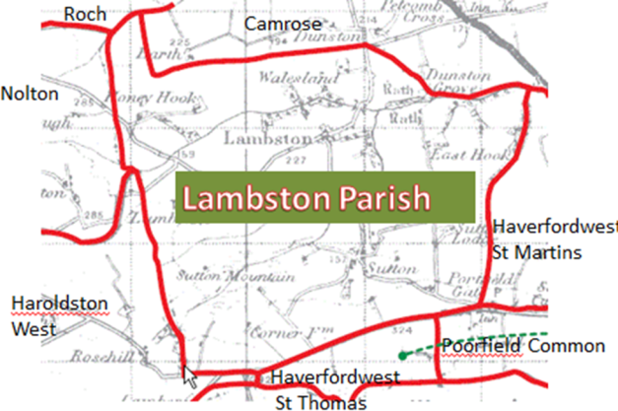
Some Lambston people you may know or recall

Slide 2
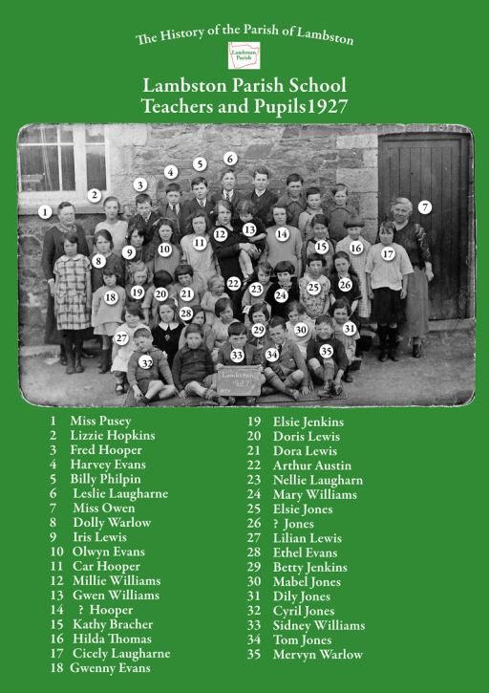

Slide 3
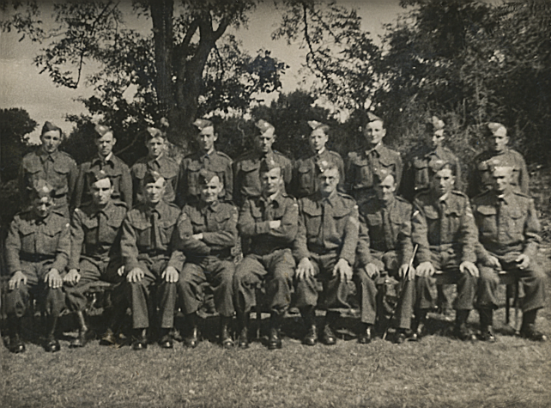
Lambston Home Guard (photo courtesy Diana Arlett)

Slide 4
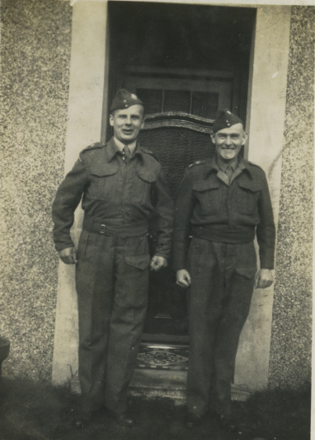
Victor Noott & Gordon Reynolds
(Photo courtesy of Diana Arlett)

Slide 5
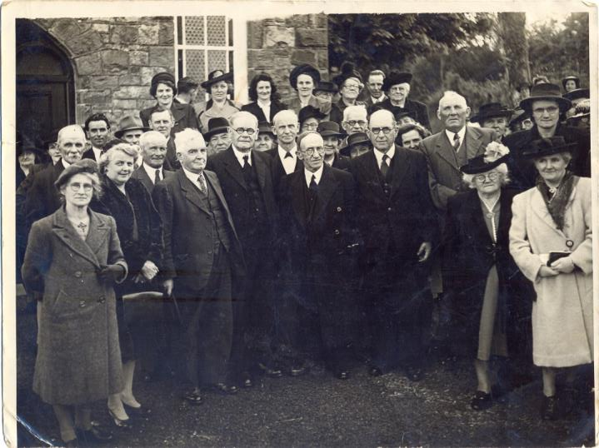
Lambston and Camrose Chapel

Slide 6
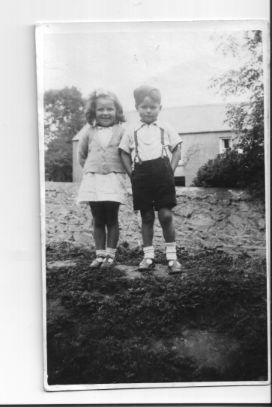
Dorothy Evans and Tony Noott on the bank by the pump in Sutton

Slide 7
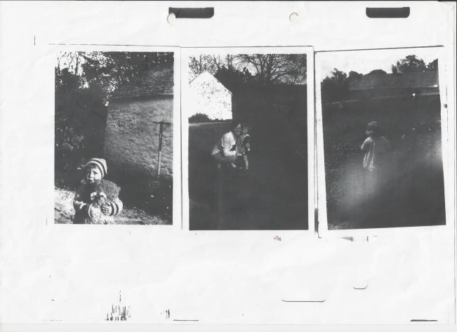
Sutton House (Patricia Rice ) 1930s

Slide 8
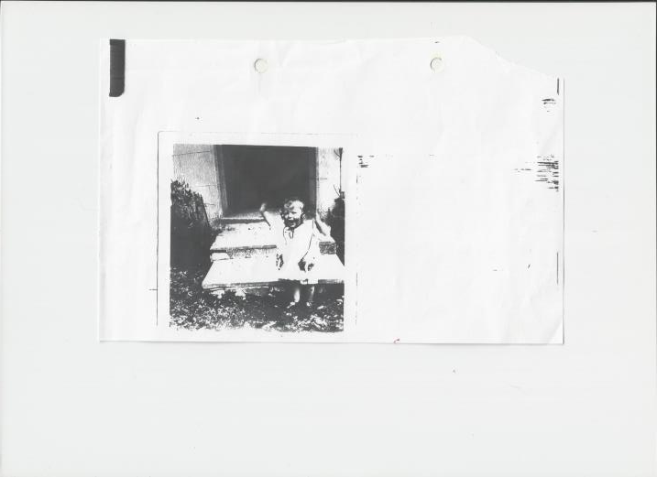
Patricia Rice (Later Paddy Ladd) Sutton House doorway 1930s

Slide 9
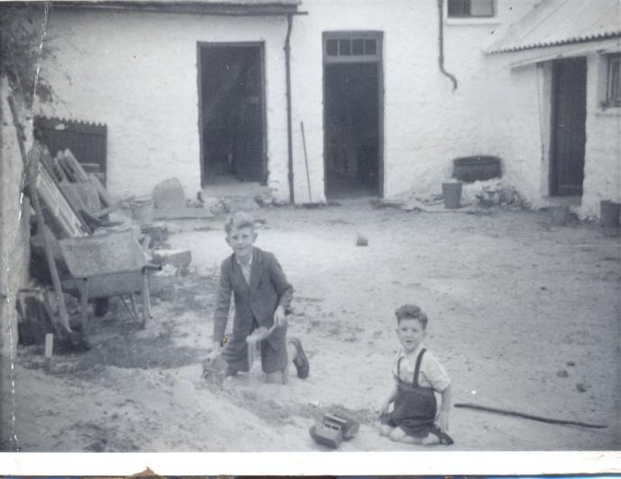
The Roberts brothers of Corner Farm (photo courtesy of Brenda Roberts)

Slide 10
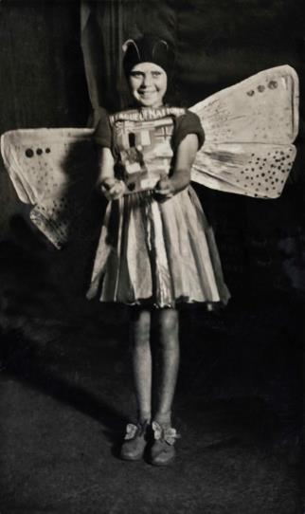
Margaret Jenkins in League of Nations Costume around 1945

Slide 11
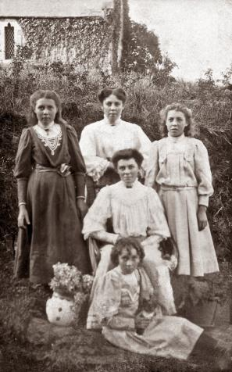
The John Family (photo from Mr & Mrs Jim Harries, Folly Cross)

Slide 12
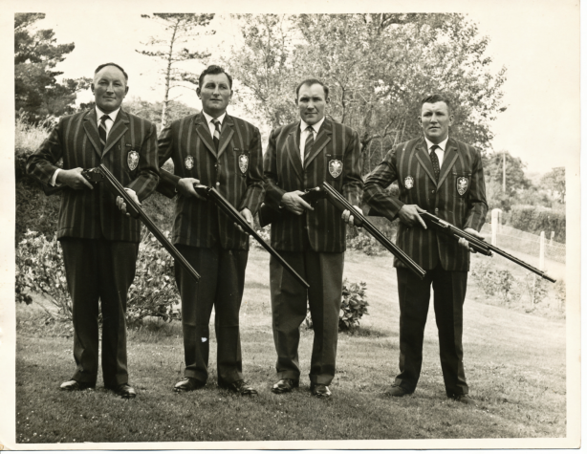
The John brothers of Lambston Hall (Photo courtesy of John Family)

Slide 13
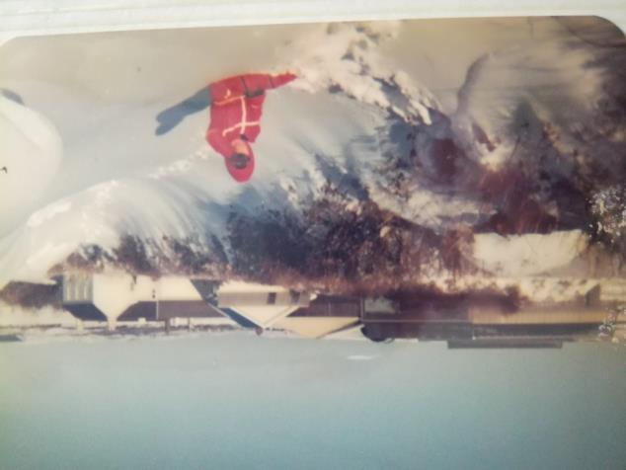
Lambston in Snow (Photo courtesy of John Family – 1982?)

Slide 14
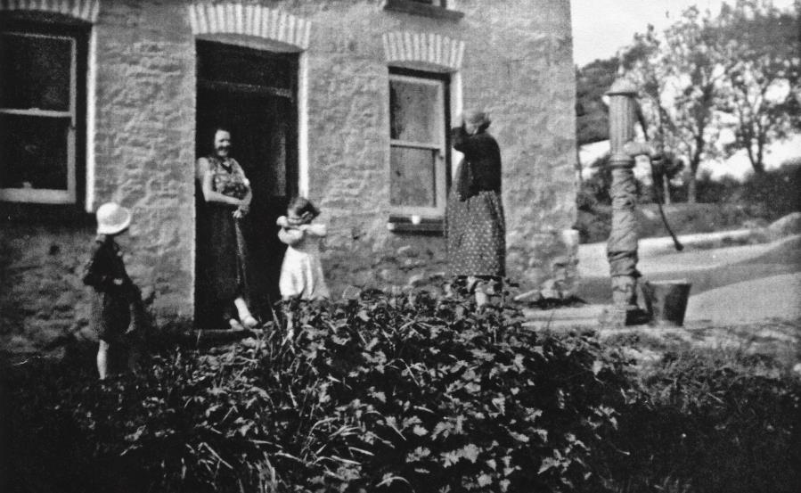
Haydn & Polly John and Martha and Mary Laugharne

Slide 15
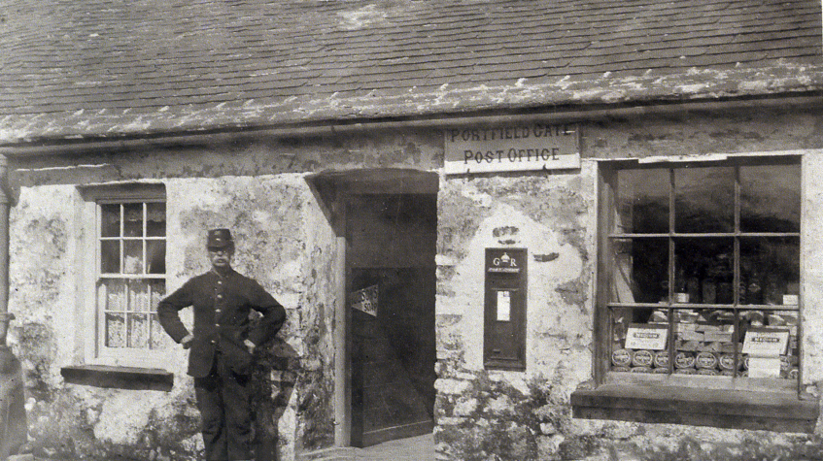
Arthur Jones outside the
Portfield Gate Post Office

Slide 16
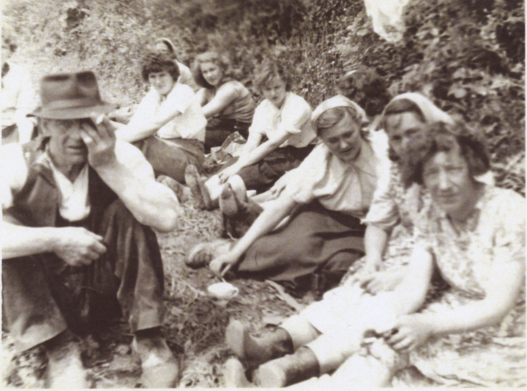
Sydney, Grace & Sybil Thomas, Elsie Jones & Evera Roberts (Photo courtesy of Thomas family)

Slide 17
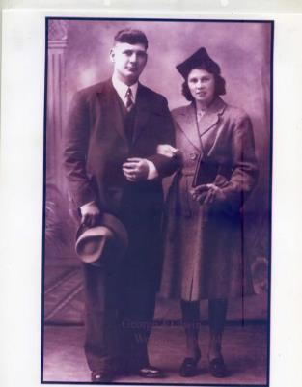
George and Olwen Swales
Portfield Gate (photo courtesy of Gordon Lewis)

Slide 18
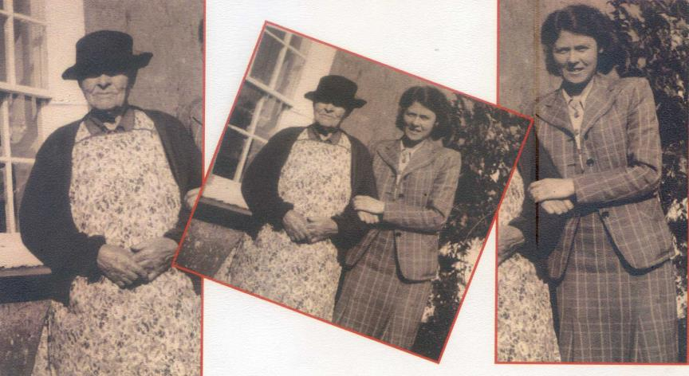
Mrs Swales & her mother (photo courtesy of Gordon Lewis)

Slide 19
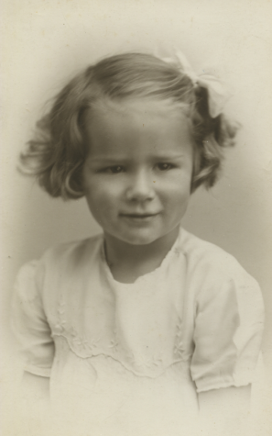
Diana Noott School House 1930s (photo courtesy Diana Arlett)

Slide 20
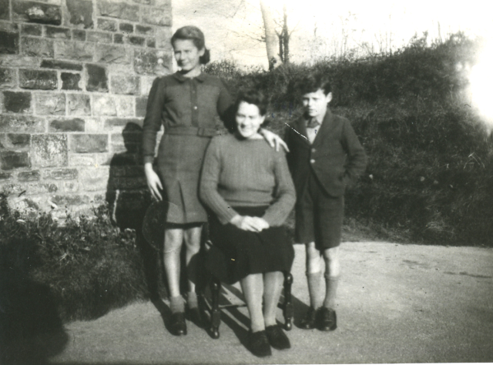
Mrs Noott & the children School House Sutton (photo courtesy Diana Arlett)

Slide 21
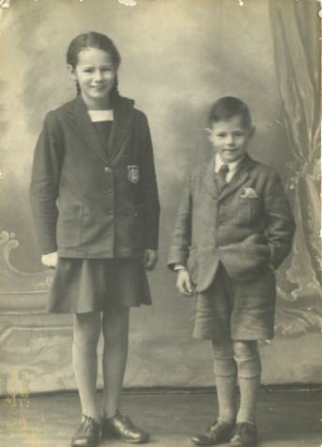
Diana & Tony Noott (photo courtesy Diana Arlett)

Slide 22
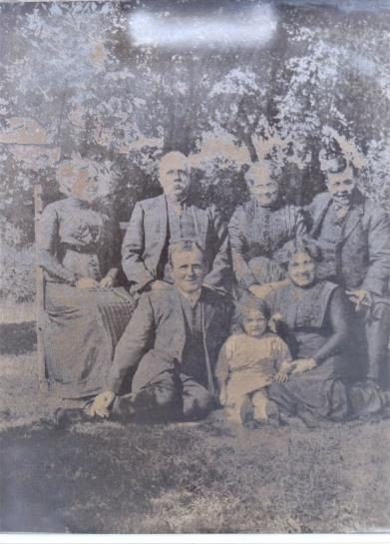
Philpin Family; East Hook 1930s?

Slide 23
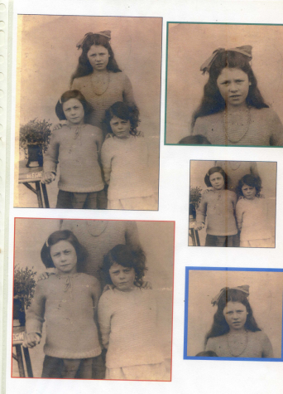
Evans sisters (photo courtesy of Gordon Lewis)

Slide 24
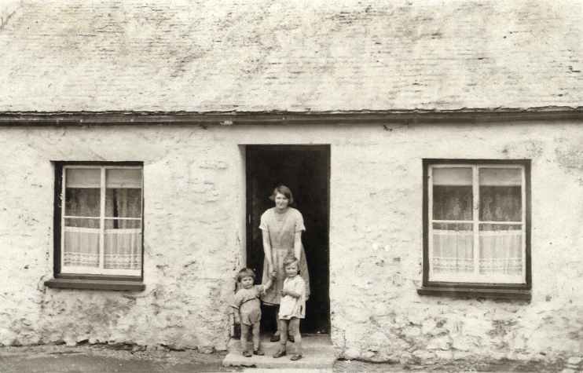
Annie Thomas (photo courtesy of Gordon Lewis)

Slide 25
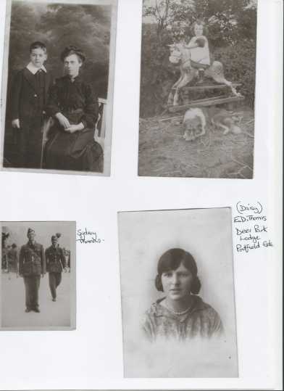
Thomas Family Deer Park Lodge
(Photos courtesy of Thomas Family)

Slide 26
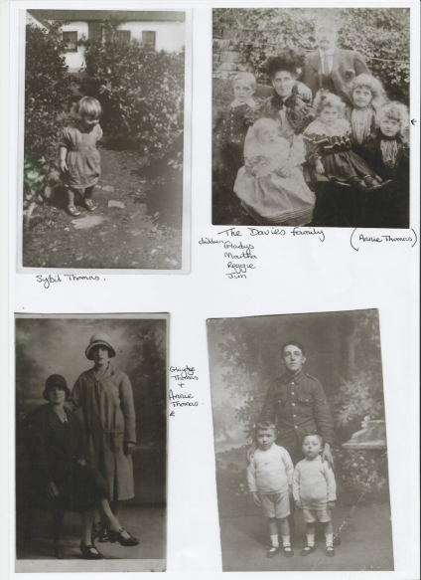
Davies & Thomas Family Portfield Gate
(photos courtesy Thomas Family)

Slide 27
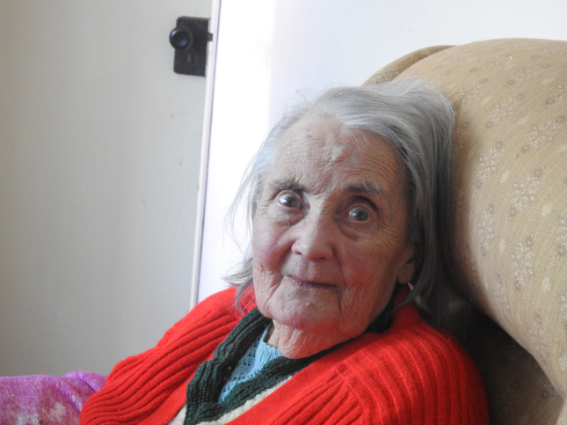
Evera Roberts No 1 (The Shop) Portfield Gate (photo courtesy of Sue Watts)

Slide 28
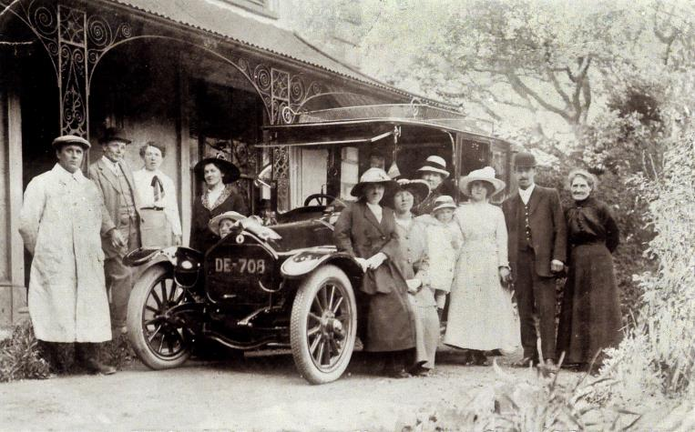
Rosehill; the residence of Captain Charles Rose and his wife . The wedding of Sarah Mary James (Cissie) daughter of William and Mary James Rosehill to John Manly James son of John and Annie Mary James Sutton West . Also in the picture is Ernie or Eric Holt (driver). (photo courtesy of Marion Maclean-Walker)

Slide 29
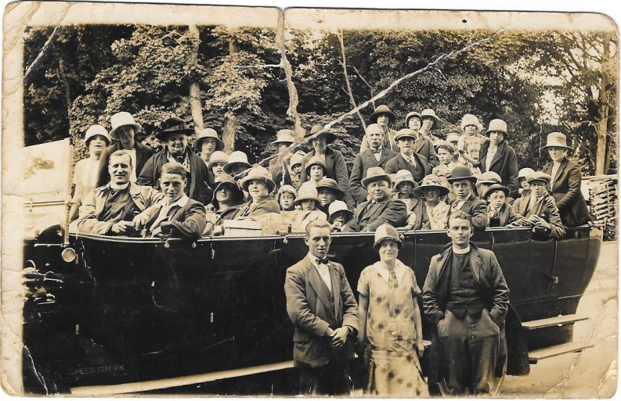
Trip to Tenby – do you recognise anyone? (photo courtesy of Marion Maclean-Walker)

Slide 30
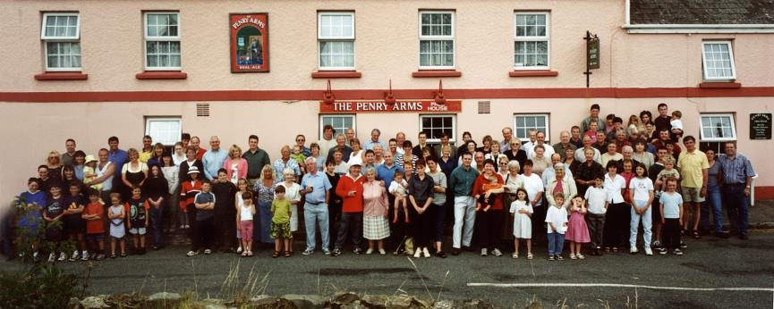
Millennium Picture;
Lambston Residents (Photo courtesy of Daniel Valla)

Slide 31
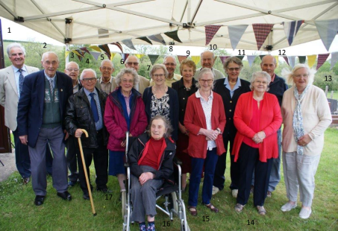
Lambston School Reunion 2019
Ex-Pupils who Attended
Name | New Surname | Used to live at | Present Location | Number in photo
David Marr |  | Westhill Fold | Simpson Cross | 10
Helen Marr | Jones | Westhill Fold | Haverfordwest | 9
Tom Evans |  | Tonna Ho PG | Lambston | 8
John Evans |  | Tonna Ho PG | Haverfordwest | 2
Diana Noott | Arlett | Old School House | Brighton | 11
Tony Noott |  | Old School House | Bristol | 12
Don Evans |  | 2 Hillside Portfield Gate | Crundale | 1
Keith Absalom |  | Midway Hse. PG | Neyland | 4
George Lewis |  | Tower Hill | Llanelli. | 6
Vera Jones | Bowen | Homeland | Cardigan | 17
Margaret Jenkins | Rees | School House | Aberystwyth, | 7
Maureen Lee | Jenkins | Bramble Hall | St Nicholas | 14
Gwyn Devonald |  | Sutton Lodge Cottage & Bramble Hall | Haverfordwest | 5
Billy Devonald |  | Sutton Lodge Cottage & Bramble Hall | Haverfordwest | 3
Grace Thomas | Colwill | Portfield Gate |  | 13
Mary James | Morgan | Rosehill | Haverfordwest | 16
Sybil Thomas | McCormack | Portfield Gate | Haverfordwest | 15

Slide 32
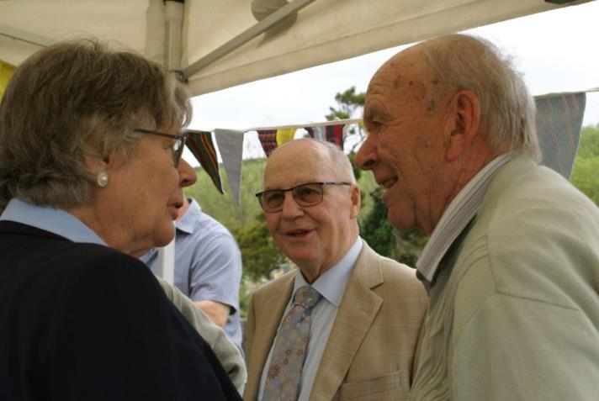
Lambston School Reunion 2019

Slide 33
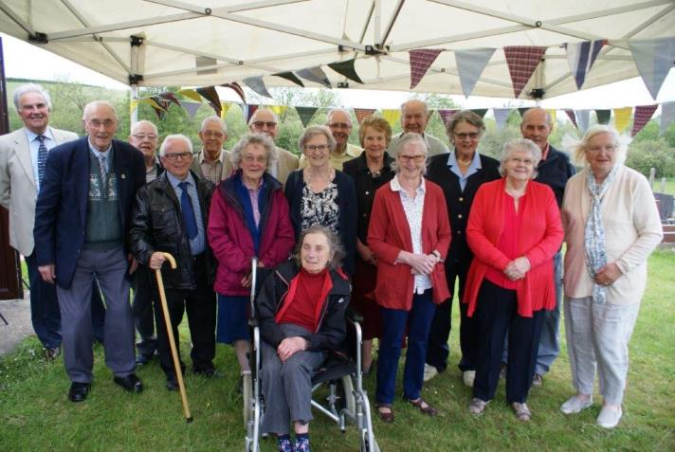
2019 Lambston School Reunion
(Photo courtesy of Joy Spiers)

