Slide 1
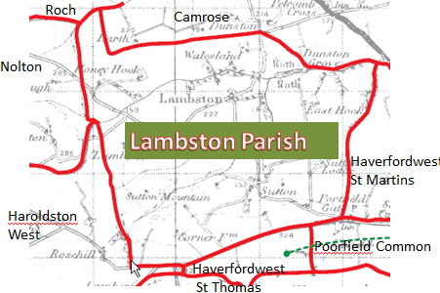
Portfield Gate Buildings: Then and Now

Slide 2
Portfield Gate
Ruined Moravian Chapel 1860s (Copyright Pembrokeshire Archives)
Tonna House today

Slide 3
The Penry Arms, Portfield Gate
Ron and Ann Groves;
Landlords in Late 1970s
2011 converted into homes

Slide 4
Millennium Picture

